Slide 1
Interventional Radiology and Hepatocellular carcinoma Management.
DR LAWRENCE MUGAMBI M’ARITHI. INTERVENTIONAL RADIOLOGIST KENYATTA NATIONAL HOSPITAL
15th November 2025

Slide 2
DECLARATION
NOTHING AT ALL TO DECLARE.

Slide 3
MAIN IR ROLES
1: Diagnostic
2: Local-regional therapies (ablation, embolization, radiation) are imaging-guided tumor-directed procedures considered in treatment for patients with hepatocellular carcinoma and liver metastasis.
Embolization
A-TACE
B-TARE
B-Bland embolotherapy
Other treatment: RFA, CRYOTHERAPY, MICROWAVE

Slide 4
Percutaneous image guided biopsies
Sample for histology, IHC, molecular studies.
Use co-axial biopsy needle and embolize the tract using biodegradable embolics.
? Need for biopsy when imaging and tumor markers are very suggestive
Biopsy:
Atypical imaging findings.
Patient with no features of CLD.
Treatment decision (molecular profiling).
Unclear etiology- Mixed HCC and cholangiocarcinoma.

Slide 5
TACE
Minimally-invasive method of administering chemotherapy directly to a liver tumor via a catheter under fluoroscopy guidance.
The chemo-embolic agent may be delivered as a mixture of chemo-drugs and lipiodol (conventional TACE) or as an injection of drug-eluting beads (DEB-TACE). Prior to the procedure pharmacy loads chemotherapeutic agent onto DEBs.
Transcatheter arterial embolization (TAE), also known as bland embolization- chemotherapy agent added-an alternative to TACE
TARE-Radio isotopes conjugated to microspheres
Over 95% of the blood supply to a liver tumor is derived from the hepatic artery,
80% of the blood supply to the normal liver parenchyma is from the portal vein.
TACE has evolved as from 1980’s.

Slide 6
TACE
MAIN INDICATIONS
unresectable HCC -usually BCLC stage B
1: Either as palliative treatment or as a bridge to a liver transplant
2 : Adjunct to RFA or Systemic chemotherapy.
Hepatic mets - commonly from colorectal ca
Intrahepatic cholangiocarcinoma

Slide 7
TACE
CONTRAINDICATIONS
Tumor infiltration throughout the liver.
Large burden of extra-hepatic metastases.
Encephalopathy.
Anaphylaxis to iodinated contrast.
Severe renal dysfunction
Severe liver dysfunction
Technical issues- Significant AV Shunts which cannot be closed.

Slide 8
TACE
Relative CI
Tumor characteristics: Large tumor burden - >50% of the liver or hypovascular tumors.
Liver function: Mildly reduced vs tumour size
Obstructive biliopathy
Portal vein invasion:
Other comorbidities

Slide 9
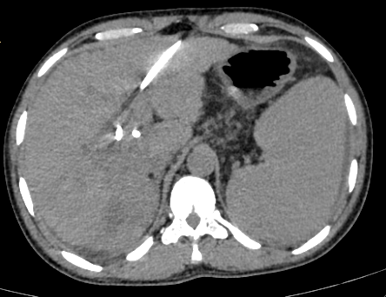
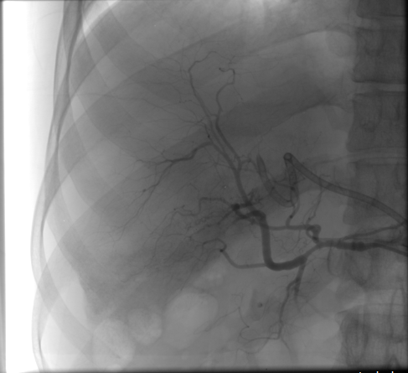
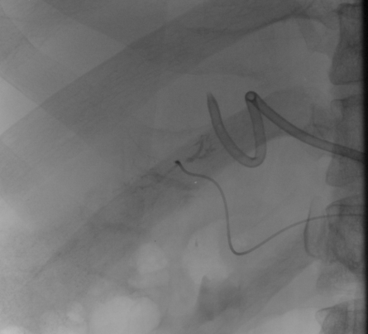

41 yrs. old with mixed HCC-Cholangiocarcinoma and obstructive biliopathy.

Slide 10
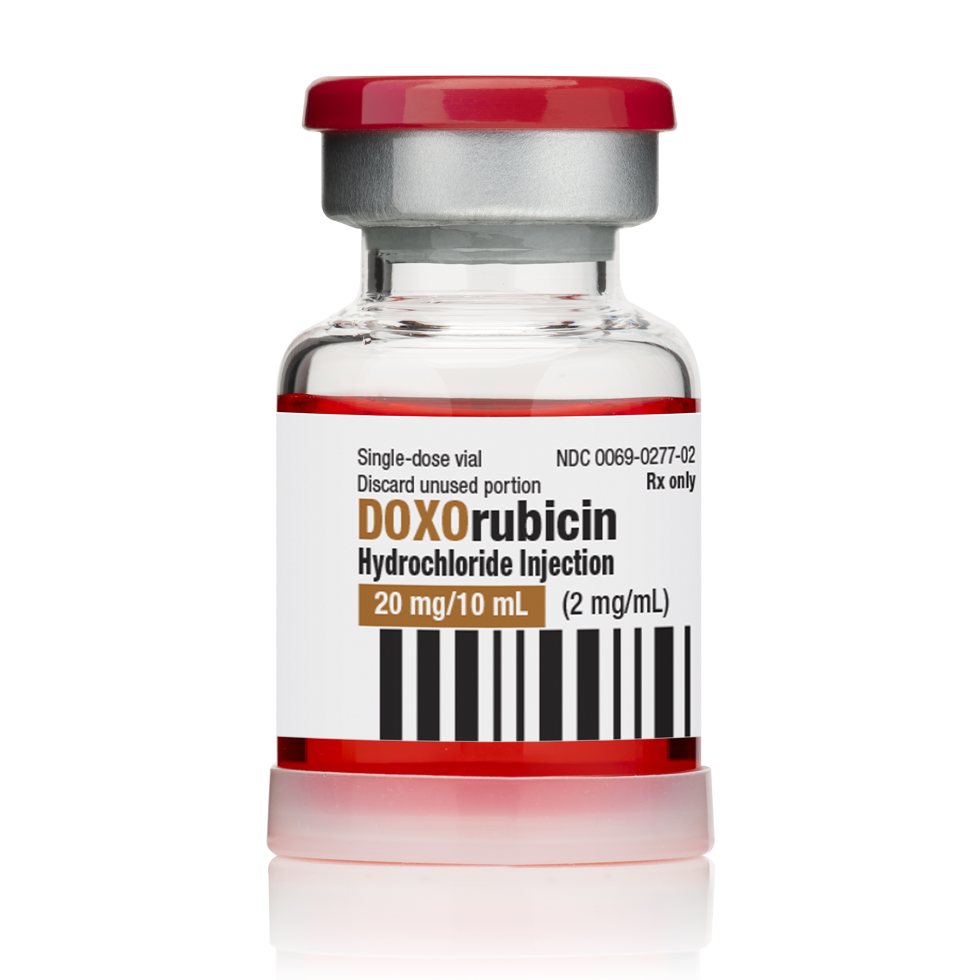
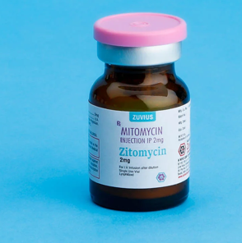
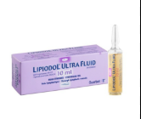
CHEMO-DRUGS/EMBOLICS
Embolic agents: Gel foam, PVA.
Medications: Doxorubicin(50mg), Mitomycin maximum of 10mg,Cisplatin
lipiodol[ maximum of 4800mg per session)

Slide 11
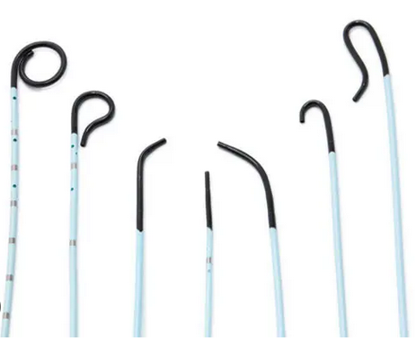
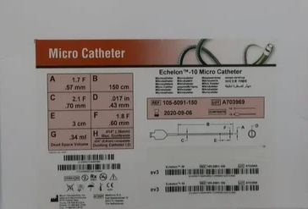
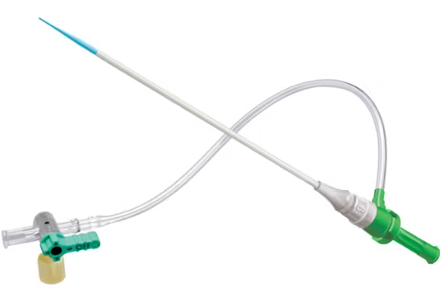
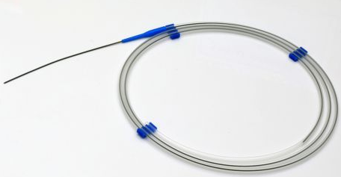
VASCULAR ACCESS DEVICES
Vascular access sheaths
Angiographic catheters
Microcatheters

Slide 12
TACE
TECHNIQUE
TRANS FEMORAL ACCESS
RCFA then celiac trunk catheterization.
Selective hepatic artery catheterization.
Selective distal catheterization using microcatheter.
Injection of the drug then embolization using gel foam or PVA
Cone beam CT- during embolization
Trans-radial / Distal radial – puncture distal to superficial palmar arch (now showing).
vessel diameter
Barbeau test

Slide 13
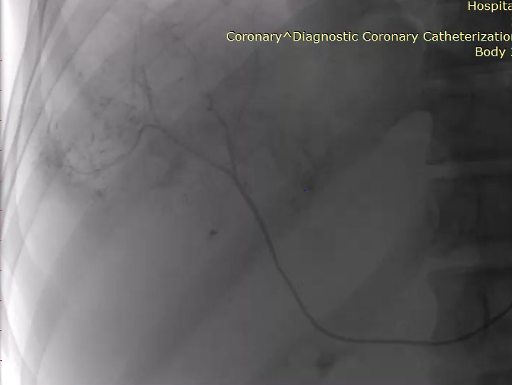
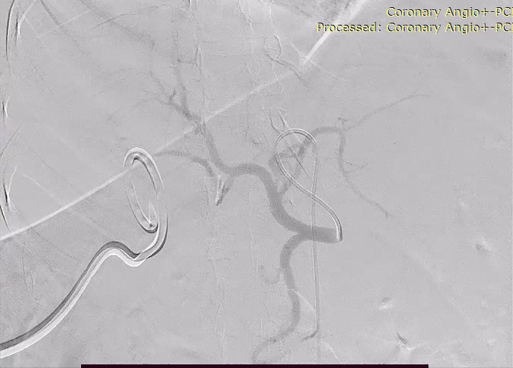

Slide 14
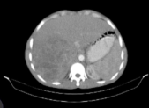
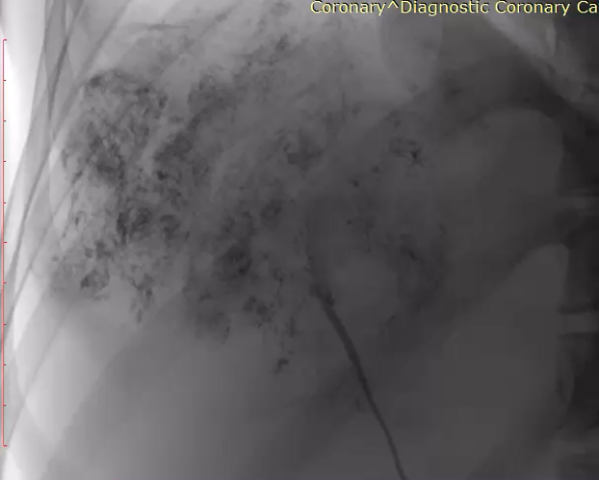
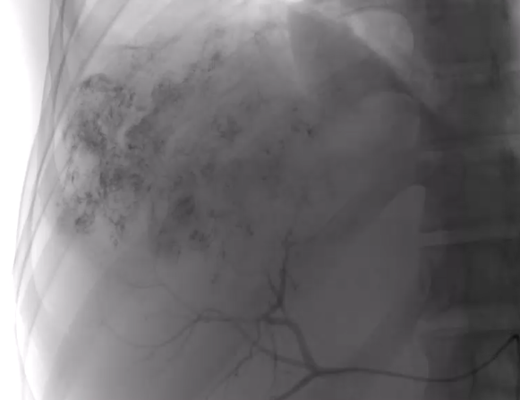


Slide 15
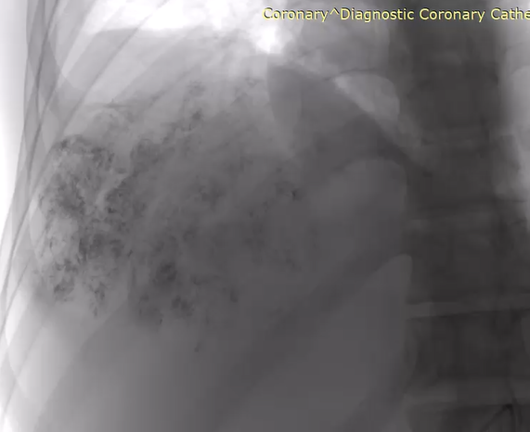
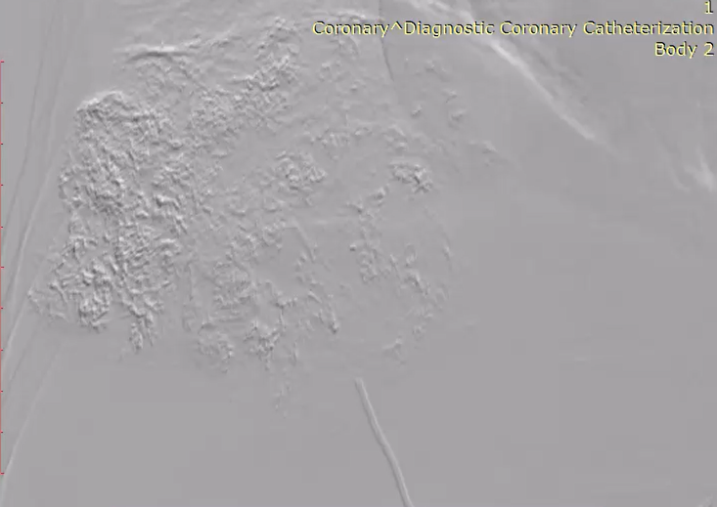

Slide 16
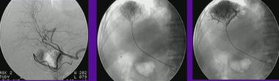
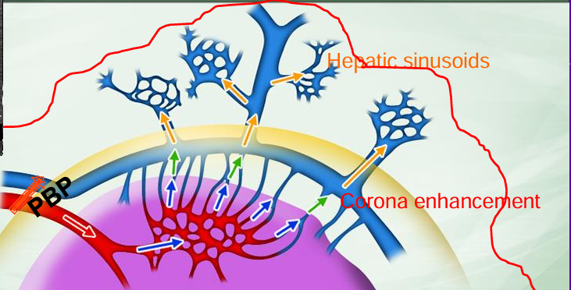
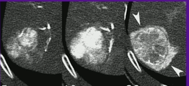
TACE-END POINT
FILL:
1: The tumor
2: The drainage
3:Beyond the capsule.

Slide 17
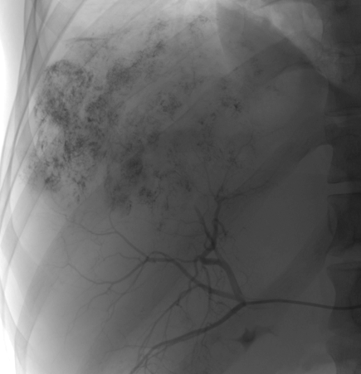
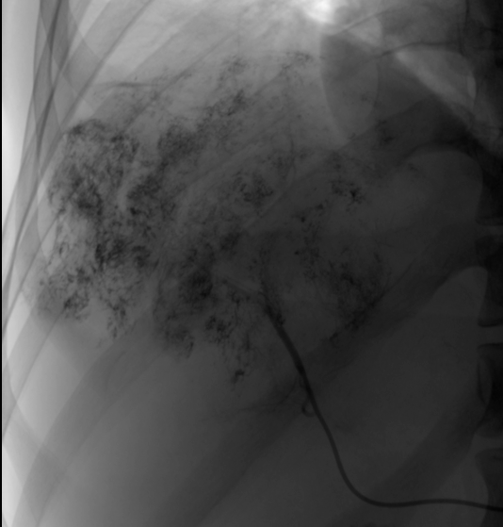

Slide 18
TACE
COMPLICATIONS
vascular injuries
non-target embolization due to hepatic artery variations and hepatico-pulmonary arterio-venous shunting.
post-embolization syndrome – very common
myelosuppression
infections
Biliary duct injury (biliary system is perfused by the hepatic artery).
TACE induced liver failure.
Tumor rupture.

Slide 19
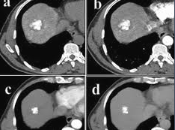
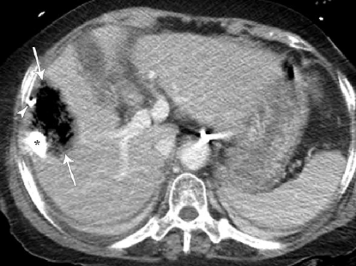
FOLLOW UP
CT SCAN
To evaluate the effectiveness of the treatment by looking for residual or new tumors.
Ideal duration.
1: 4-6 weeks post TACE
2: 3-6 months
3: Annually

Slide 20
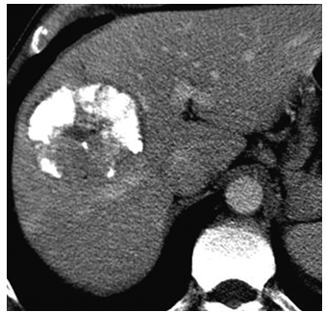
CLASSIFICATION BASED ON LIPIODOL ACCUMMILATION
Homogeneous accumulation (Type I).
Partial defect (Type II).
Faint accumulation (Type III).
No or slight accumulation (Type IV).

Slide 21
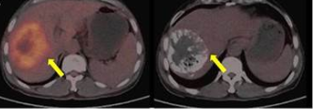
PET CT Scan will assess for viable remnant tumor

Slide 22
TARE-Trans-arterial radio-embolization
Directed therapy that uses radioactive microspheres delivered through catheter to the liver tumours. The radioactive radio-isotopes are conjugated to microspheres.
Uses yttrium-90-filled microspheres, Lipiodol labeled with iodine¹³¹ or rhenium¹⁸⁸ .
Two types of microspheres commonly used.
a)Glass-made TheraSphere®.
b)Resin-made Sir-Spheres®.
Combines delivery of internal radiation to tumor, with embolization of feeding artery.

Slide 23
TARE (Hepatico-pulmonary/enteric shunt)
An AV shunt allows blood to bypass the liver's capillary system and flow directly from the hepatic artery to the systemic circulation and then into the lungs and the gastro-enteric circulation.
More worry of the lungs- severe radiation pneumonitis.
Pre-procedural scan by infusion of Technetium-99 labelled macroaggregated albumin-99mTc-MAA into the hepatic artery.
A special scan (SPECT/CT) tracks these particles to measure the percentage that reaches the lungs- Hepatico-pulmonary shunt fraction(HPSF).
Contra indication to TARE depends mostly on the microspheres used to conjugate the radioisotope.
Resin microspheres: CI if HPSF is greater than 20%.
Glass microspheres: CI if the expected lung dose is greater than 30 Gy in a single session or 50 Gy cumulatively- associated with high HPSF.

Slide 24
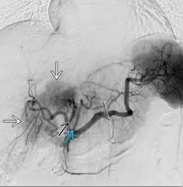
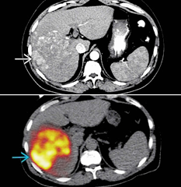

Slide 25
OTHER MANAGEMENTS
RFA
MICROWAVE
CRYOTHERAPY

Slide 26
POST TACE/TARE OVERALL SURVIVAL RATE
Depends on factors like cancer stage, liver function, and overall health. median survival can range from roughly 14 to 20 months for both procedures.
Some studies suggest TARE may offer longer event-free survival in certain cases.
The longest recorded survival for a patient with HCC after TACE is over 14 years. Achieved by a patient who underwent multiple sessions of therapy.

Slide 27
THANK YOU ALL

